Slide 1
Generating Effective Item Recommendations for Etsy Users
Shirmung Bielefeld
Howard Jing
Karen Li

Slide 2
Item Recommendation Systems
important for commercial websites
show users items relevant to their interests
incite users to purchase items

Slide 3
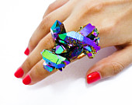
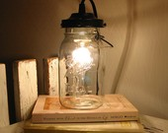
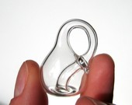


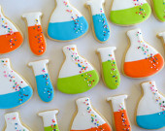
Etsy is the world’s handmade marketplace.

Slide 4
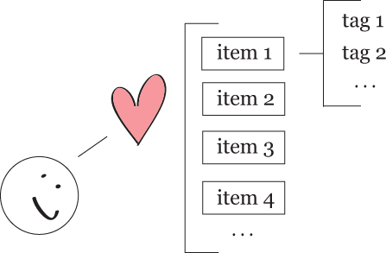

Slide 5
We believe that…
an item’s set of tags is a relatively accurate representation of that item
users favorite items according to their interests
users’ interests can be discerned by their favorite items’ set of tags

Slide 6
Difficulties
unable to determine what users don’t like (ie: no ranking system)
unable to access private information (ie: user clicks, user purchases)

Slide 7
Our Data
using Etsy’s API
collect tags of items that one user (corduroy) has marked as a favorite item
collect tags of “randomly” selected items

Slide 9
Experimental Setup
4-fold cross-validation
use majority of corduroy’s favorite items as the training set
use a small portion of corduroy’s favorite items along with random items as the testing set
error based on whether or not this portion is present at the top of recommendation list

Slide 10
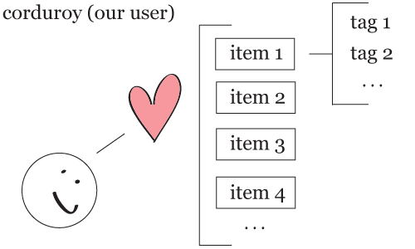
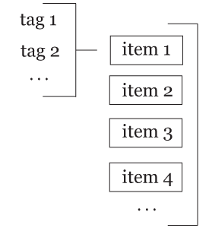
Item-Based Collaborative Filtering Using the k-Nearest Neighbor

Slide 11
Cosine Similarity

Slide 12
Item-Based Collaborative Filtering Using the k-Nearest Neighbor

Slide 13
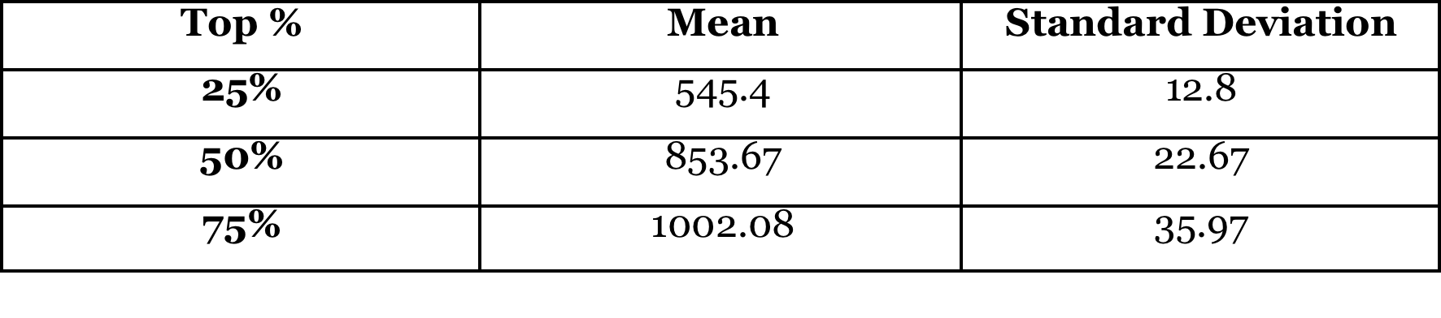
Mean Number of corduroy’s Favorite Items…
…within the top n% of the 5972 total items

Slide 14
2D Line Plot
green lines represent corduroy’s favorite items
red lines represent random items

Slide 15
Cumulative Distribution

Slide 16
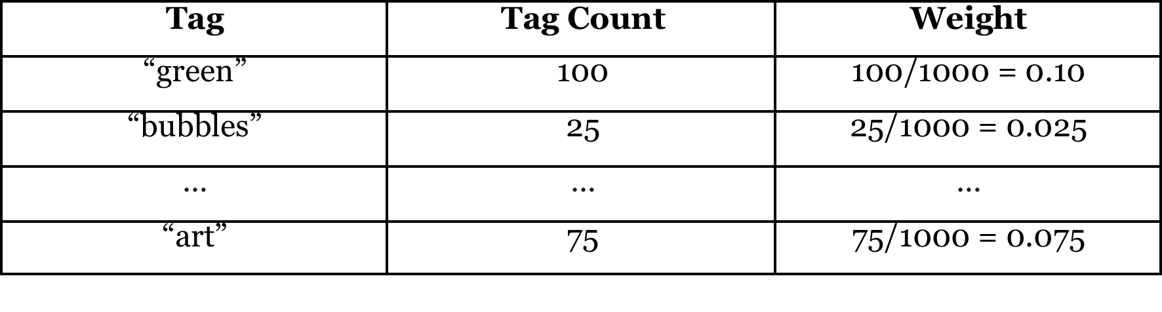
Revealed Preference Through Weighted Tags
weigh tags based on their occurrence count
form weight look-up table for evaluating the preference of an item

Slide 17
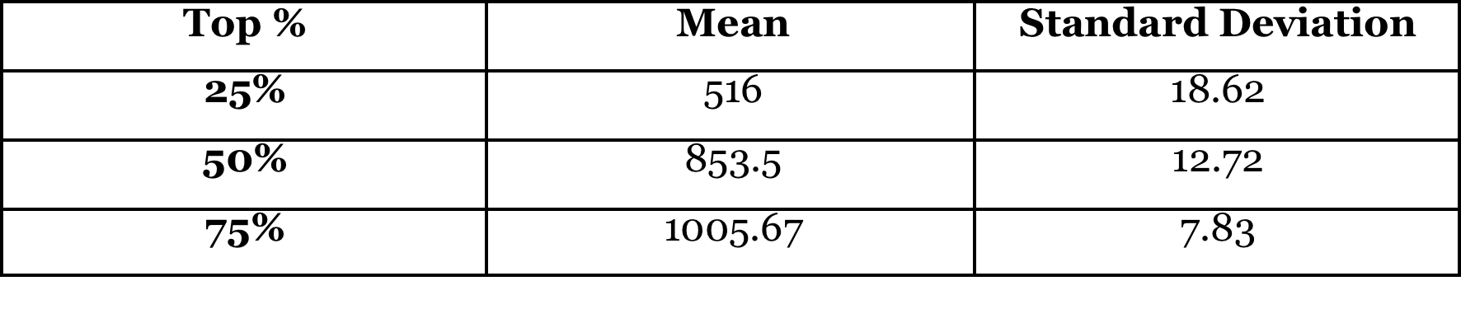
Mean Number of corduroy’s Favorite Items…
…within the top n% of the 5972 total items

Slide 18
2D Line Plot
green lines represent corduroy’s favorite items
red lines represent random items

Slide 19
Cumulative Distribution

Slide 20
Effects of Ignoring Top Categories
ignore random items’ tags that are also top categories (ie: “supplies”, “accessories”)
potentially weight rarer and more specific tags more heavily

Slide 21
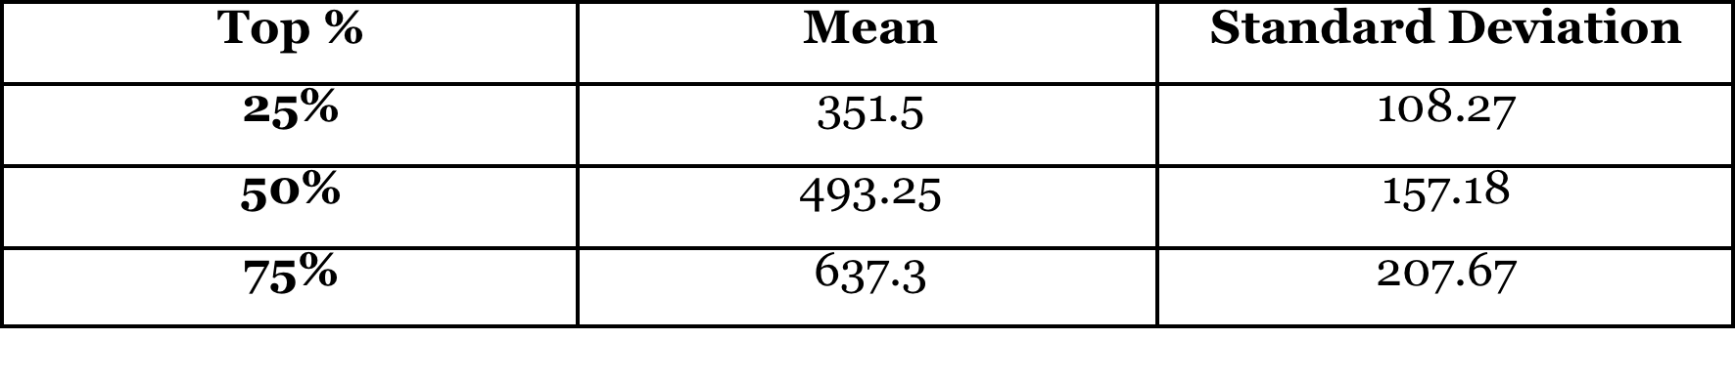
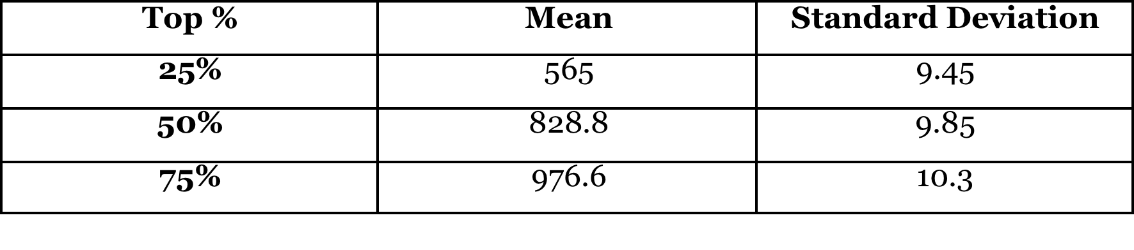
Mean Number of corduroy’s Favorite Items…
Item-Based Collaborative Filtering Using the k-Nearest Neighbor
Revealed Preference Through Weighted Tags

Slide 22
2D Line Plot
Item-Based Collaborative Filtering Using the k-Nearest Neighbor
Revealed Preference Through Weighted Tags

Slide 23
Cumulative Distribution
Item-Based Collaborative Filtering
Using the k-Nearest Neighbor
Revealed Preference
Through Weighted Tags

Slide 24
Conclusions
overall fairly happy with results
corduroy’s favorite items that were included in testing set tended to cluster towards the top of recommendation list
recommend items above certain threshold

Slide 25
Future Considerations
generating item recommendations based on user similarity
grouping tags that are similar to or correlate with each other

Slide 26

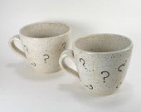


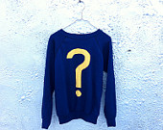

Questions?

Slide 27
References
http://public.research.att.com/~volinsky/netflix/cfworkshop.pdf
http://ilk.uvt.nl/~toine/publications/bogers.2009.recsys2009-workshop.pdf
http://www.springerlink.com/content/m812ng6155r2v7l6/fulltext.pdf

